Slide 1

BIKE SALES DATASET ANALYSIS-TABLEAU
REINFORCEMENT PROJECT-3
JOTHEESWARAN S
DA&DS
FEB’25
12/05/2025

Slide 2
INTRODUCTION TO DATASET
This dataset contains detailed records of bike sales in the United States, comprising 1,000 entries.
It encompasses sales data from various regions and multiple showrooms across the country.The dataset covers a time period ranging from 2022 to 2023.
It includes key details such as sales date,price,discounts applied and payment information. Additionally, it provides the names of the sales representatives who facilitated each sale.
This dataset serves as a comprehensive source for analyzing sales performance and trends across different regions and showrooms during the specified period.

Slide 3
DATA DESCRIPTION
CONSISTS OF FOLLOWING COLUMNS
1.BIKE_ID
2.BIKE NAME
3.BIKE CATEGORY
4.PRICE
5.DISCOUNT VALUE
6.SHOWROOM NAME
7.REGION
8.SALES DATE
9.SALES REP NAME
10.PAYMENT METHOD
11.EMI STATUS
12.BANK NAME
This dataset, generated using Mockaroo, provides simulated records of bike sales in the United States.
It spans transactions conducted across multiple regions and showrooms.
The data captures key details regarding sales trends, pricing structures, and payment methods, as well as insights into the involvement of sales representatives and financial institutions.

Slide 4
DATA PREPARATION
1. Data Collection
Used Mockaroo AI generator
Defined custom schema with 12 fields
2. Data Cleaning
Removed blanks and duplicates
Fixed date formats, spellings, and capitalization
3. Data Validation
Checked character types and data types
Ensured consistency across all fields
4. Data Export
Exported clean data to Excel
5. Data Visualization
Imported dataset into Tableau

Slide 5
KEY CALCULATIONS
AVG([Price])
-[Price]
COUNT([Unique Bike Id])
([DISCOUNT VALUE]/[Price])*100
[Discount]*10
[Price]-[DISCOUNT VALUE]

Slide 6
CALCULATIONS DESCRIPTIONS
AVG([Price]) → Calculates the average price of all bikes.
-[Price] → Returns the negative value of the price
(used in inverse comparisons or visual tricks).
COUNT([Unique Bike Id]) → Counts the number of unique bikes sold.
([DISCOUNT VALUE]/[Price])*100 → Calculates the discount percentage offered on each bike.
[Discount]*10 → Multiplies the discount value by 10
(can be used for scaling or testing custom logic).
[Price] - [DISCOUNT VALUE] → Gives the final selling price after applying the discount.

Slide 7
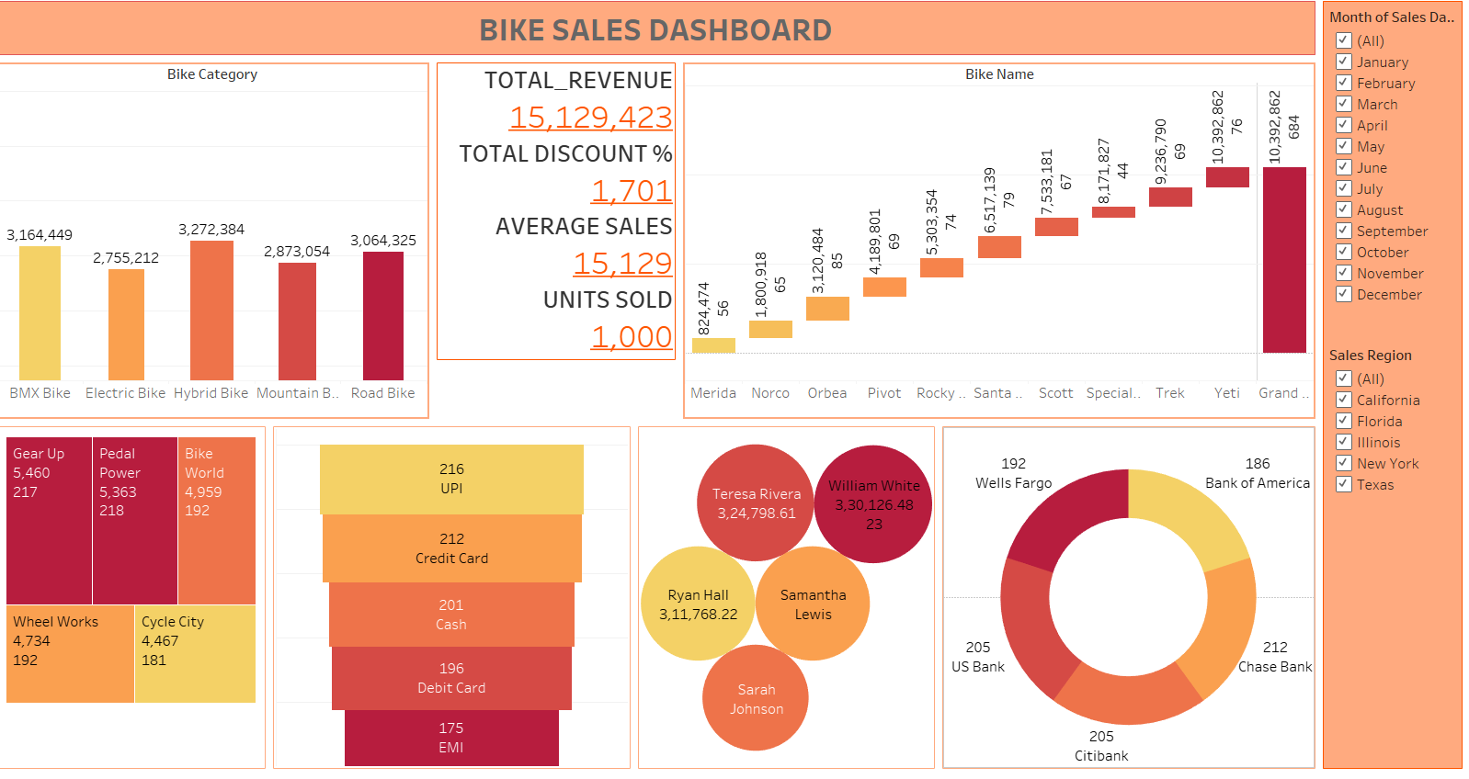
DASHBOARD

Slide 8
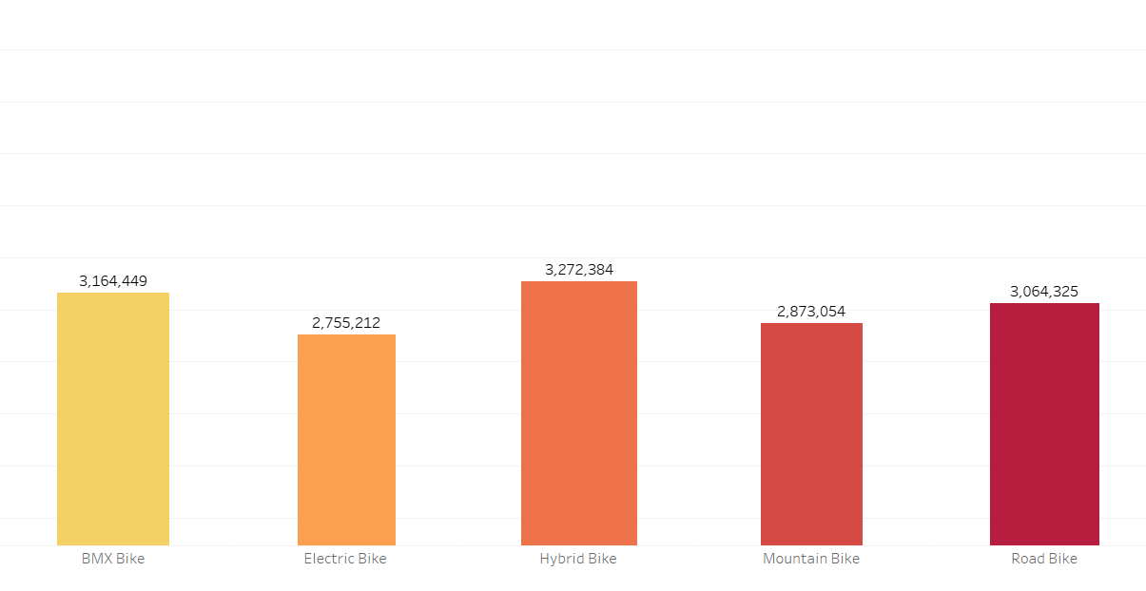
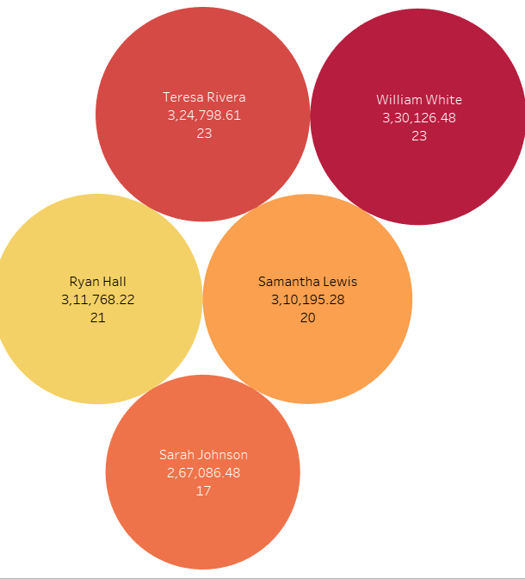
INSIGHTS

Slide 9
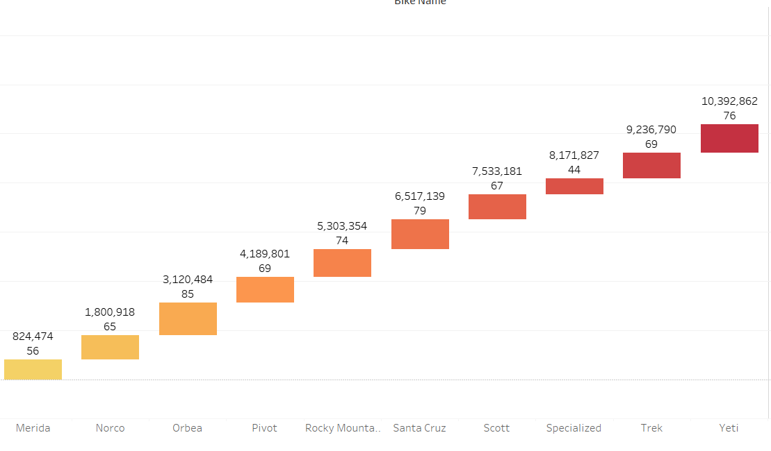

Slide 10
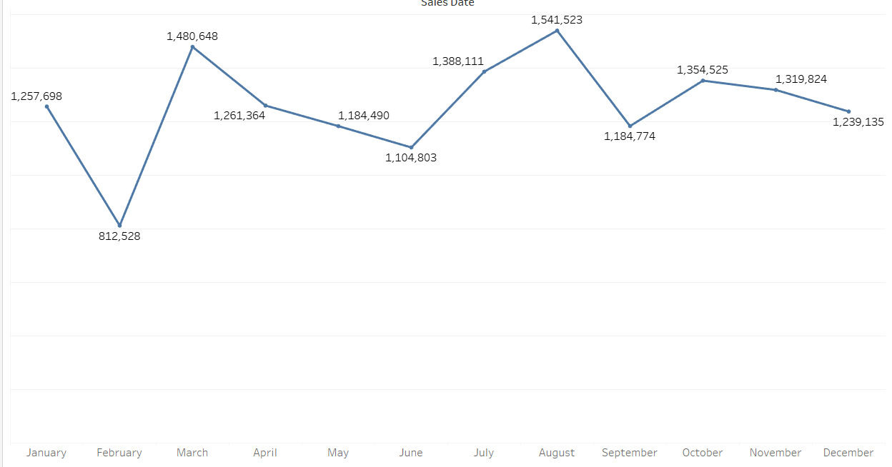
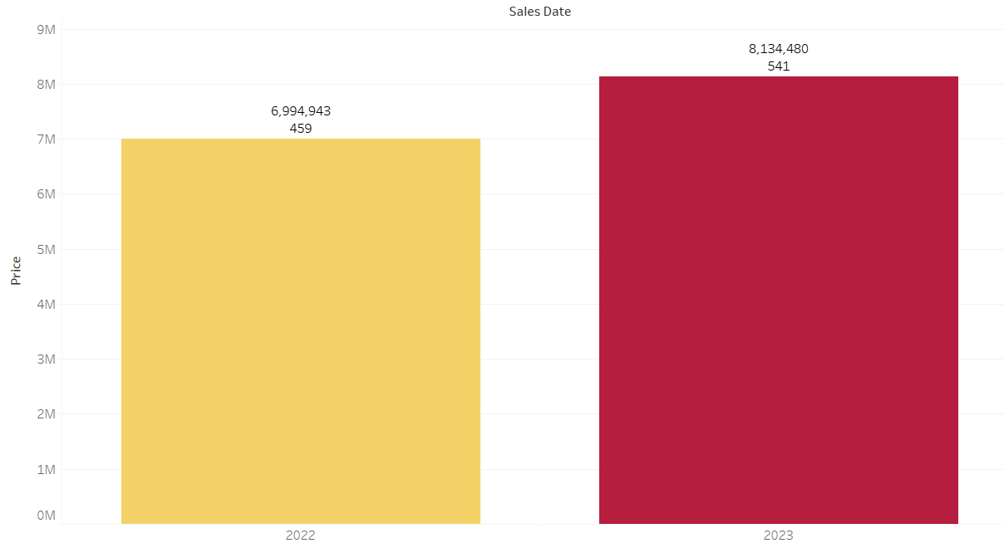

Slide 11
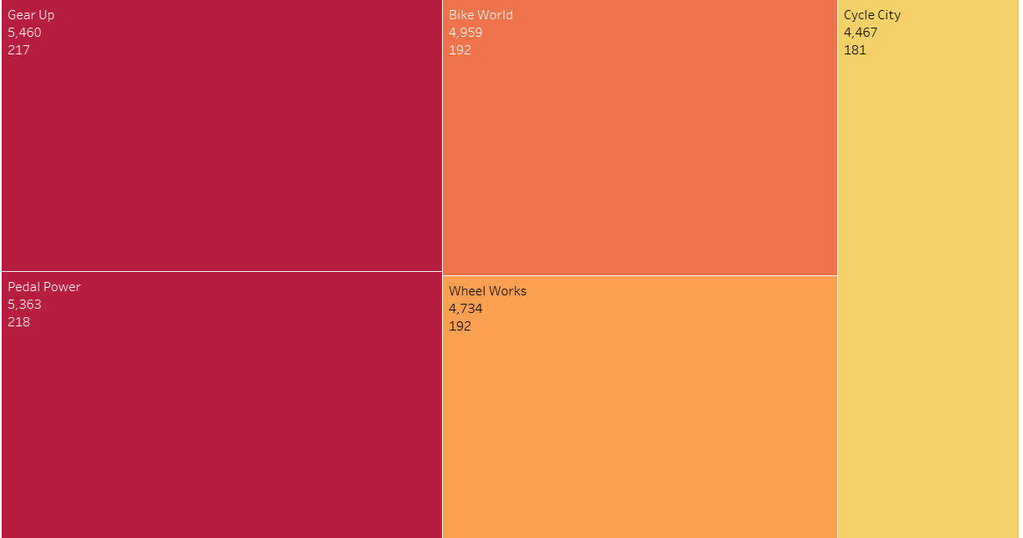
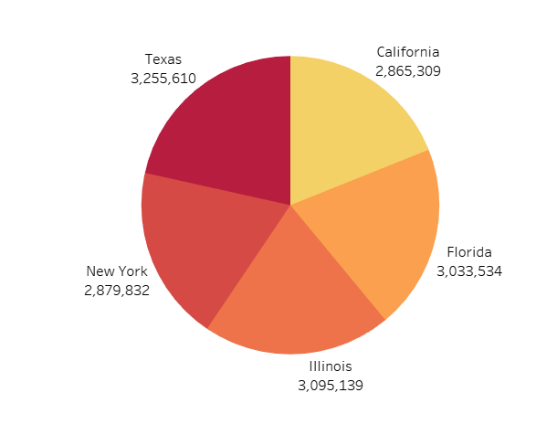

Slide 12
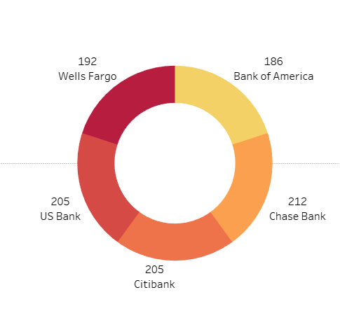
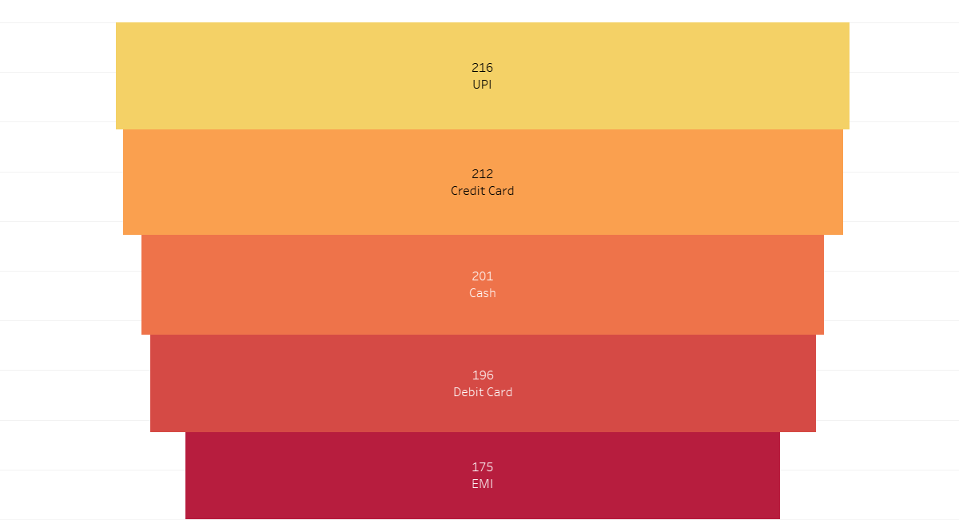

Slide 13
KEY INSIGHTS
Seasonal Demand: Sales peak between May and August, with June and July being the highest indicating strong seasonal buying behavior.
Best-Selling Category: Hybird Bikes consistently outperform all other categories in both units sold and revenue.
Low Off-Season Sales: Significant drop in sales from November to February, suggesting reduced demand in winter months.
Stable Revenue Patterns: Revenue closely follows unit sales, meaning prices remain relatively stable across months (few discounts or price shifts).
Underperforming Category: Electric Bikes have the lowest sales volume, regardless of season.

Slide 14
RECOMMENDATION
Maximize Peak Season: Boost inventory, marketing, and advertising before the summer surge (April–August) to capture high demand.
Winter Sales Strategy: Run off-season discounts, bundle offers, or service promotions (like tune-ups) to maintain engagement in winter.
Promote Low-Selling Categories: Create targeted campaigns or offer bundles for Touring Bikes to increase visibility and sales.
Introduce Pre-Season Launches: Launch new models in early spring (March–April) to catch early interest and pre-orders.
Use Data for Stock Planning: Align production and restocking with historical demand to avoid overstocking or stockouts.

Slide 15
CONCLUSION
Strong Seasonality Detected: Bike Sales Are Clearly Influenced By The Time Of Year, With Summer Months Driving The Highest Performance.
Hybird Bikes Dominate: This Category Leads In Both Popularity And Revenue, Suggesting It's The Core Product Line For The Business.
Revenue Follows Volume: Since Revenue Trends Mirror Unit Sales, The Company Maintains Consistent Pricing Strategies Throughout The Year.
Opportunities In Off-peak Months: The Off-season Represents A Chance For Creative Promotions, Diversification, Or Service-based Offerings.
Data-driven Growth Potential: Leveraging These Insights Can Help The Business Optimize Inventory, Boost Marketing And Improve Overall Sales Strategy.

Slide 16
THANK YOU!

